Slide 1
Containers and Docker
Daniel Wang – Cloud Solutions Architect

Slide 2
What is a container?
A container is an isolated environment that allows us to build and run software packages.
These software packages include the code and all dependencies to run applications quickly and reliably on any computing environment. We call these packages container images.
The container image becomes the unit we use to distribute our applications.

Slide 3
What is software containerization?
Software containerization is an OS virtualization method that is used to deploy and run containers without using a virtual machine (VM – hardware virtualization).
Containers can run on physical hardware, in the cloud, VMs, and across multiple OSs.

Slide 4
Virtualization versus containerization?
Virtual machine
Container
Application XYZ
Application
App dependencies
Dependencies
Guest OS
Image
C
C
C
C
C
VM
VM
VM
VM
VM
VM
Dependency 1
Dependency 2
Hypervisor 2
Docker Engine
Hypervisor 1
Host OS
Host OS
Hardware
Hardware
Hardware
Type 1
Type 2
Virtualization
Containerization

Slide 5
The benefits of using containers
Agility
Ship apps faster
Portability
Easily move workloads
Density
Achieve resource efficiency
Rapid scale
Scale easily to meet demand

Slide 6


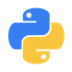

The benefits of using containers
Any OS
Anywhere
Any app
Any language
Java
Linux
On-premises
Monolith
.Net
Python
Windows
Cloud
Microservice
Node

Slide 7
Benefits of a container architecture
Containers are a packaging mechanism in which applications are abstracted from the environment in which they run. This allows container-based applications to be deployed easily and consistently, regardless of whether the target environment is a private data center, the public cloud, or even a developer’s personal laptop.
Repeatable and productive
Container-hosted code is reusable and portable (Build, Ship, and Run).
Containers are consistent across development, test and production.
Containers can be defined in smaller units than a VM, lowering cost and enabling apps to scale more granularly.
Fast and efficient
Fast and agile app deployment with DevOps built-in and instant startup.
Containers don’t require a separate operating system and use less resources.
An application deployed in a container may perform better than when the same app is deployed in a VM.
Technology/platform agnostic
Build it once, run it anywhere: containers run on any cloud, without changes to code.
Containers support all frameworks and technology stacks.
Notes:
Benefits of a container architecture are plentiful, including:
Working with containers is repeatable and more productive.
Containers are reusable, portable (“Build, Ship, and Run”) and consistent across development, test and production.
Containers are fast and more efficient than VMs – they enable fast and agile app deployment and instant startup.
Since containers do not require a separate operating system, they use less resources and the tend to be more cost-effective.
Containers are platform independent - build it once and run it anywhere: containers run on any cloud, and even on premises, without changes.
Containers support all frameworks and technology stacks.

Slide 8
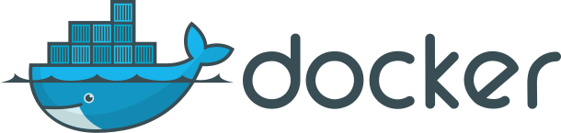
What is ?
An open source container runtime platform with
Mac, Windows and Linux support
# The world’s simplest Dockerfile
$ cat Dockerfile
FROM scratch
COPY hello /
CMD ["/hello"]
# Let’s create a docker image “tagged” hello-world
$ docker build –t hello-world .
# And run it…
$ docker run hello-world

Slide 9
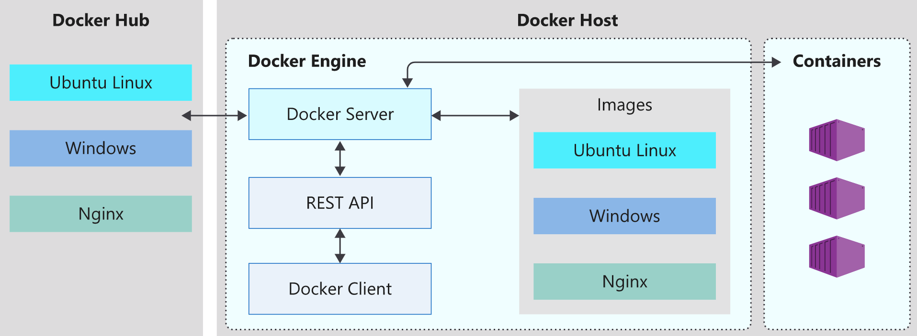
Docker Architecture
The Docker platform consists of several components that we use to build, run, and manage our containerized applications.

Slide 10
What is a container image?
A container image is a portable package that contains software. It's this image that, when runs, becomes the container. The container is the in-memory instance of an image.
A container image is immutable. Once you've built an image, the image can't be changed. The only way to change an image is to create a new image.
What is a base image?
A base image is an image that uses the Docker scratch image. The scratch image is an empty container image that doesn't create a filesystem layer. This image assumes that the application you're going to run can directly use the host OS kernel.
What is a parent image?
A parent image is a container image from which you create your images. For example, instead of creating an image from scratch and then installing Ubuntu, we'll rather use an image already based on Ubuntu. We can even use an image that already has Nginx installed. A parent image usually includes a container OS.

Slide 11
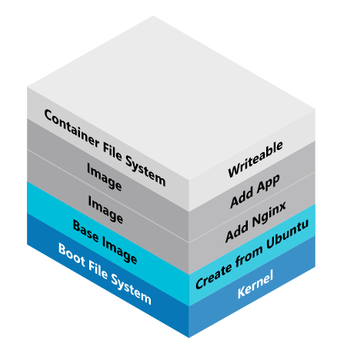
What is the Stackable Unification File System (Unionfs)?
Unionfs is used to create Docker images. Unionfs is a filesystem that allows you to stack several directories, called branches.
Unionfs allows you to add and remove branches as you build out your file system.

Slide 12
What is a Dockerfile?
A Dockerfile is a text file that contains the instructions we use to build and run a Docker image. The following aspects of the image are defined:
The base or parent image we use to create the new image
Commands to update the base OS and install additional software
Build artifacts to include, such as a developed application
Services to expose, such a storage and network configuration
Command to run when the container is launched
FROM microsoft/dotnet:2.2-aspnetcore-runtime AS base
WORKDIR /app
EXPOSE 80
FROM microsoft/dotnet:2.2-sdk AS build
WORKDIR /src
COPY . .
RUN dotnet restore MyWebApp.csproj
RUN dotnet build "MyWebApp.csproj" -c Release -o /app
FROM base AS final
WORKDIR /app
COPY --from=build /app .
ENTRYPOINT ["dotnet", "MyWebApp.dll"]

Slide 13
How to create an image?
Use Dockerfile: docker build -t dotnetcore-demo .
From a container:
docker run -i -t --name geeklab centos:7 /bin/bash
[root@873abc18f59d /]#
[root@873abc18f59d /]# yum install httpd
[root@873abc18f59d /]# exit
docker commit -m="CentOS 7 With httpd installed" -a "Geek Lab" geeklab centos7/httpd:v1
docker images

Slide 14
Basic Image Operations
List images: docker images
Remove images: docker rmi debian
Tag images:
docker tag httpd:test fedora/httpd:v1.0
docker tag httpd:test myregistry.azurecr.io/fedora/httpd:v1.0
Download Images: docker pull debian
Upload Images: docker push myregistry.azurecr.io/fedora/httpd:v1.0

Slide 15
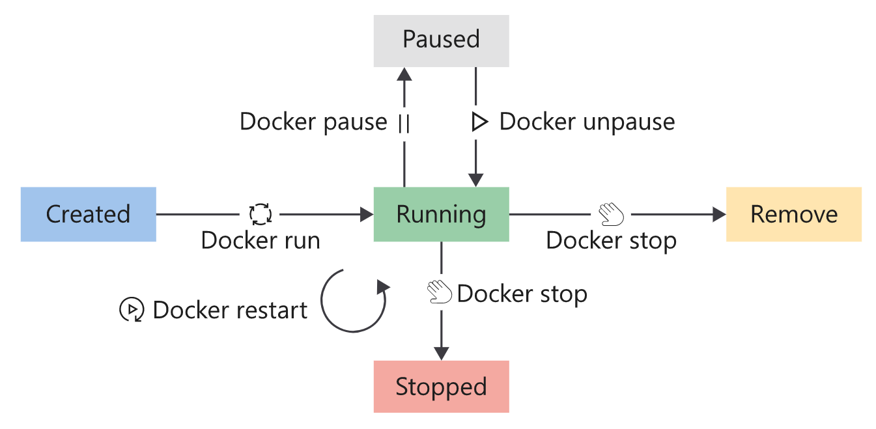
Container Lifecycle

Slide 16
Basic Container Operations
Run container: docker run -it --rm -p 8080:80 --name netcoredmo netcoredemo
List containers: docker ps -a
Stop container: docker stop netcoredemo
Parse container: docker pause netcoredemo
Restart container: docker restart netcoredemo
Remove container: docker rm netcoredemo
Inspect container: docker inspect netcoredemo

Slide 17
Container Storage
Think running container as a process, any data stored inside the container is temporary. Just like a process, data stored in memory is temporary.
What is a volume?
A volume is stored on the host filesystem at a specific folder location. We'll choose a folder where we know the data isn't going to be modified by non-Docker processes.
Docker creates and manages the new volume by using the docker volume create command. This command can form part of our Dockerfile definition, which means that we can create volumes as part of the container creation process. Docker will create the volume if it doesn't exist when you try to mount the volume into a container the first time.

Slide 18
Container Storage Samples
# create volume named logdata at default docker volume location
docker volume create logdata
# uses nfs to mount the /path/to/dir in rw mode from 192.168.1.1
docker volume create --driver local \
--opt type=nfs \
--opt o=addr=192.168.1.1,rw \
--opt device=/path/to/dir \
foo
# mount volume to /logata and list its content
docker run -d -v logdata:/logata alpine ls /logdata

Slide 19
Container Network
Docker provides us with three pre-configured network configurations:
Bridge - the default network for containers launched without specifying any network configuration. It is an internal, private network from the Docker host network. Containers connected to the bridge network are allowed to access other bridge connected containers by IP address only. The hostname defaults to the container name.
Host - The host network allows us to run the container on the host network directly. This configuration effectively removes the isolation between the host and the container at a network level.
None - We use the none network option to disable networking for containers.

Slide 20
Basic Network Operations
List networks: docker network ls
Inspect network: docker network inspect bridge
Create bridge network: docker network create --driver bridge my-net
Use bridge network: docker run -dit --name alpine1 --network my-net alpine ash
Use host network: docker run --rm -d --network host --name my_nginx nginx
Use none network: docker run --rm -d --network none --name logdata logdata

Slide 21
Thank you!

